Slide 1
Bank Looking For Clients
Explanatory Analysis of a dataset with 5000 customers
to get an idea how to sell a new product in a more efficient way.

Slide 2
What is the case?
The case is The Bank has a customers Data with various characteristics of the customers. The management built a new product - Personal Loan, and ran a small campaign towards selling the New Product to their clients.
After some time, 9% of customers have Personal Loan from The Bank.

Slide 3
What is the Goal?
To sell more Personal Loan products to Bank customers.
To devise campaigns to better target marketing to increase the success ratio with a minimal budget.
To identify the potential customers who have a higher probability of purchasing the loan.

Slide 4
What are the Questions?
As soon as we got 9% of customers who bought the Product, we got the following questions:
Is there some associations between personal characteristics and the fact that customer bought the Product? If so:
What are those Main Characteristics that have an association with the Product and what is the strength of the association?
What are the Segments of Main Characteristics, that have a higher strength of association with the Product?
What is the sample of Data with customers from Main Segments?

Slide 5
Explanatory analysis
We made a simple step-by-step analysis of customers’ characteristics to identify patterns to effectively choose the subset of customers who have a higher probability of buying a new product.

Slide 6
We performed the following steps:
Checked all twelve characteristics whether or not each of them has an association with the fact that the product has been sold.
Found FIVE main characteristics that have higher than moderate strength of association with the product.
Analyzed main characteristics and segmented each one by different strengths of association with the product.
Tried to make a subset of customers with ideal characteristics who have the highest probability of buying the product. Unfortunately, our dataset does not contain such information. So...
We build a simple algorithm to make a subset of data to get the customers’ IDs who have a high probability to buy the product.

Slide 7
Strength of association
We ran logistic regression models through the whole dataset and found FIVE Main Characteristics.
Each of these Main Characteristics have highest odds to increase the chance to sell the product with an increased value of characteristic by one unit, leaving all other characteristics the same.
We named the size of odds as strength of association.

Slide 8
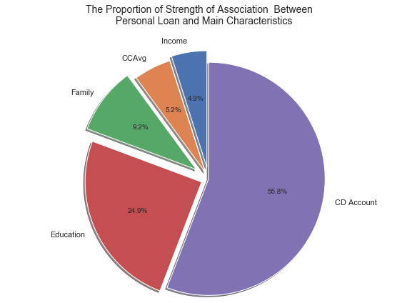
Five main characteristics
NAME ODDS
---------------------------------------
CD Account 12.02
Education 5.35
Family size 1.99
CCAvg 1.11
Income 1.05

Slide 9
What are the Segments of Main Characteristics?
For each characteristic, we ran a step-by-step analysis to identify the segments with the highest strengths of association.

Slide 10
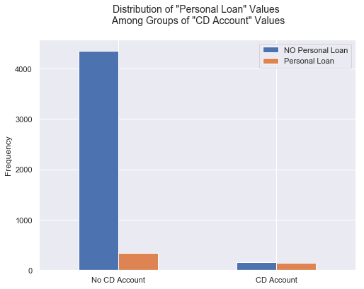
CD Account
We can say that the proportion of customers who have Personal Loan among them and have CD account is quite high.
Let’s get a closer look…

Slide 11
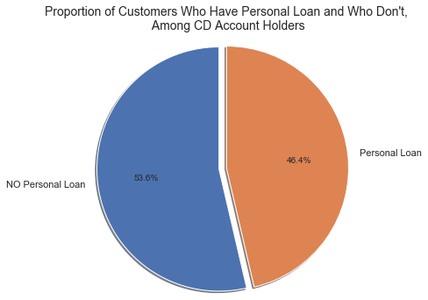
CD Account
Conclusion
46.4% of CD Account Holders have Personal Loan.
For 'CD Account' characteristic - the main segment to sell Personal Loan is the customers who already have a CD.
Target value of 'CD Account' variable = 1

Slide 12
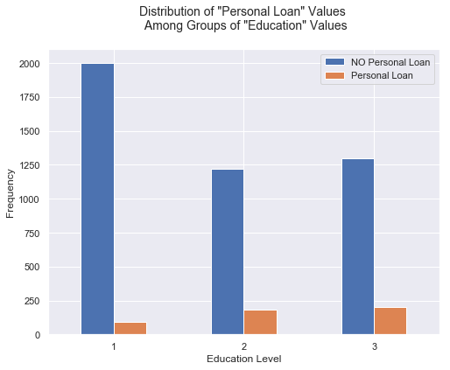
Education
We can say that the proportion of customers who have Personal Loan to those who do not among customers with 2 and 3 Levels of Education is higher than the proportion among customers who have 1 level of Education.
Let’s get a closer look…

Slide 13
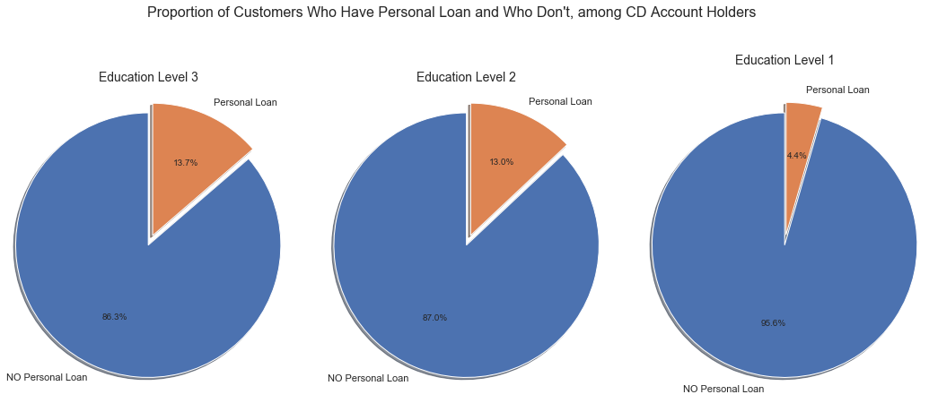
Education

Slide 14
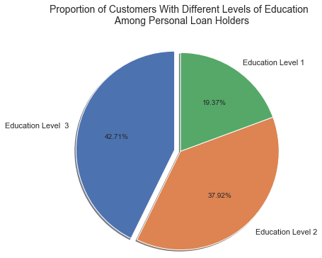
Education
Conclusion
42.7% and 37.9% of customers who have Personal Loan, have Education Level 3 and Level 2 respectively.
For 'Education' characteristic - the main segments to sell Personal Loan are the customers who have 2nd and 3rd levels of education.
Target values of 'Education' variable are 3 and 2 in descending order of priority.

Slide 15
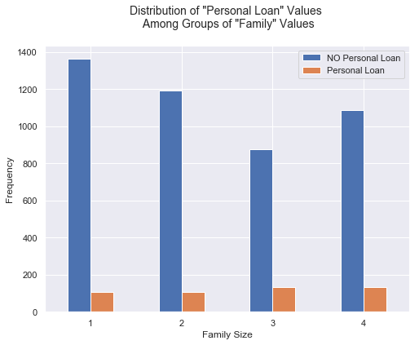
Family
We can say that the proportion of customers who have Personal Loan among them who have Family size 2 and 3 is the highest proportion.
Let’s get a closer look…

Slide 16
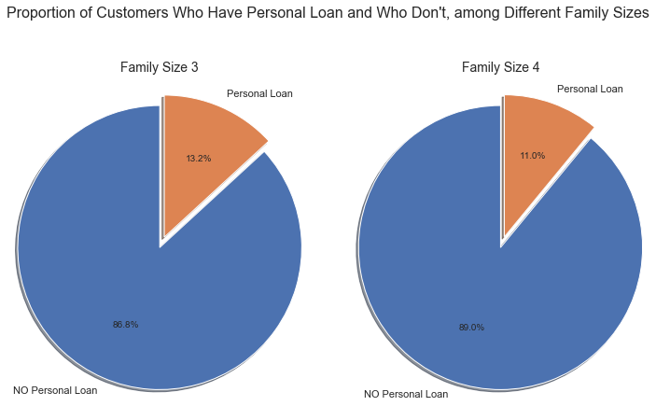
Family

Slide 17
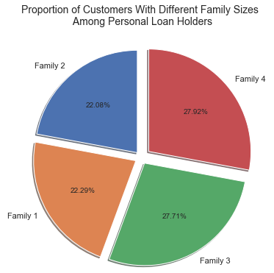
Family
Conclusion
27.9% and 27.7% of customers who have Personal Loan, have Family size Level 4 and Level 3 respectively.
For 'Family' characteristic, the main segments to sell Personal Loan are the customers who have Family Size 3 and 4.
Target values of 'Family' variable are 3 and 4 in descending order of priority, since the proportion of customers who have Personal Loan is the highest with Family Size 3 (13,2%).

Slide 18
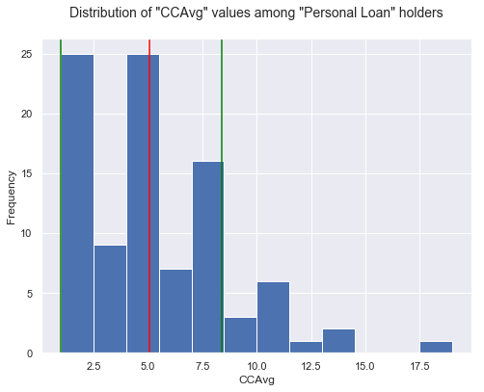
CCAvg
We can say that CCAvg characteristic values can be divided in three groups in descending order of priority consider its frequency among Personal Loan holders:
Group I: 1 < CCAvg < 2.5
Group II: 4 < CCAvg < 5.5
Group III: 7 < CCAvg < 8.5

Slide 19
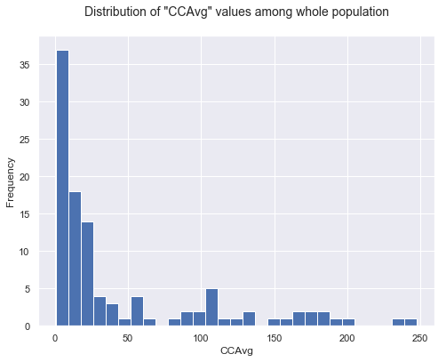
CCAvg
We can say that all of our groups of 'CCAvg’ defined as priority groups to sell Personal Loan, lie inside segment with highest frequency among whole population.

Slide 20
CCAvg Conclusion
Target groups of 'CCAvg' characteristic in descending order of priority:
Group I: 1 < CCAvg < 2.5
Group II: 4 < CCAvg < 5.5
Group III: 7 < CCAvg < 8.5

Slide 21
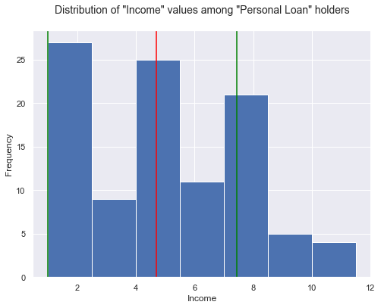
Income
We can say that 'Income' characteristic values can be divided in three groups in descending order of priority considering its frequency among Personal Loan holders:
Group I: 1 < Income < 2.5
Group II: 4 < Income < 5.5
Group III: 7 < Income < 8.5

Slide 22
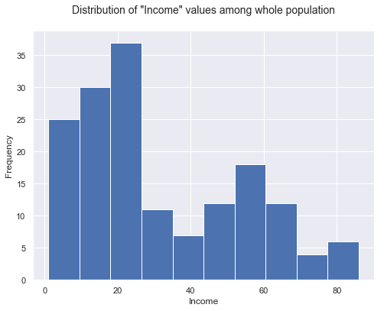
Income
We can say, that all of our groups of 'Income' defined as priority groups to sell Personal Loan, lie inside a segment with pretty high frequency among whole population.

Slide 23
Income Conclusion
Target groups of 'Income' characteristic in descending order of priority:
Group I: 1 < Income < 2.5
Group II: 4 < Income < 5.5
Group III: 7 < Income < 8.5

Slide 24
What is the sample of data with customers from Main Segments?
CD Account
1
Education
3
2
Family
3
4
CCAvg
Group I: 1 < CCAvg < 2.5
Group II: 4 < CCAvg < 5.5
Group III: 7 < CCAvg < 8.5
Income
Group I: 1 < CCAvg < 2.5
Group II: 4 < CCAvg < 5.5
Group III: 7 < CCAvg < 8.5
We found associations of the fact that a customer bought the Product and some of his/her characteristics.
We segmented each Main Characteristic with a descent order of strength of association.
With this data we are able to get subset with any combinations to get customers’ IDs who have the highest probability to buy the product.
…use file “00_main.ipynb”

